Slide 1



CalcuLcar car prıce eStımatıon app
Yavuz Selim Doğdu - 190704009
Mehmet Yavuz Gökmen - 190704004
Notes:
NOTE: Want a different image on this slide? Select the picture and delete it. Now click the Pictures icon in the placeholder to insert your own image.

Slide 2
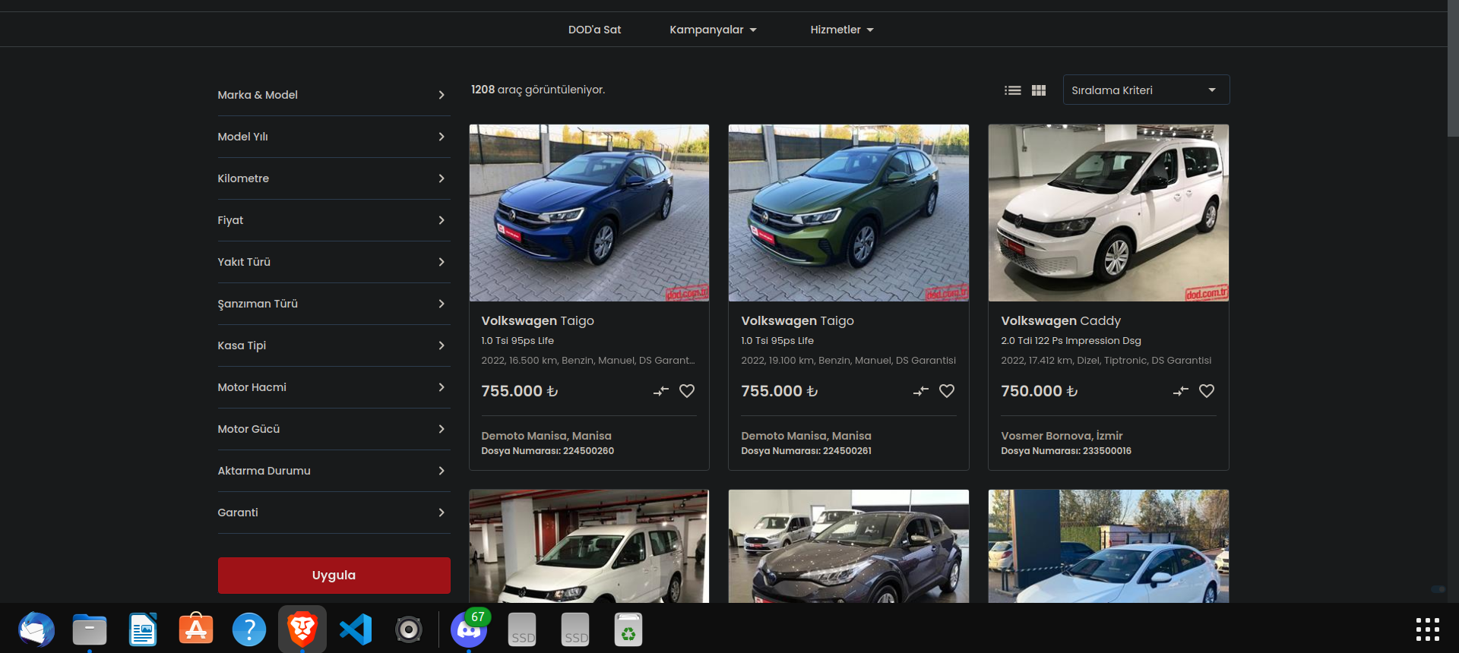
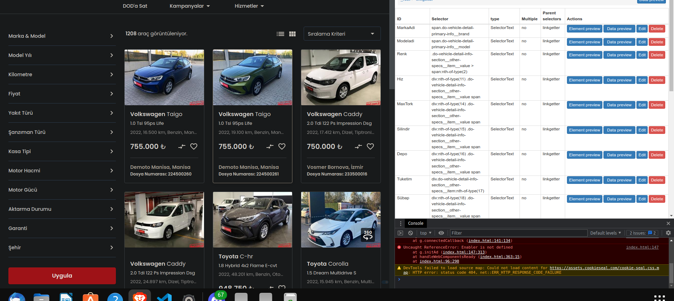
Data

Slide 3
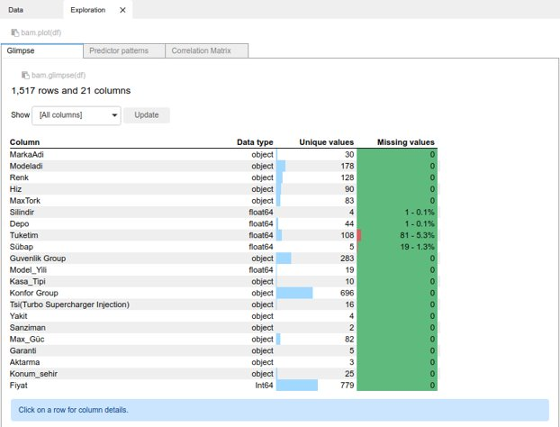
Data

Slide 4
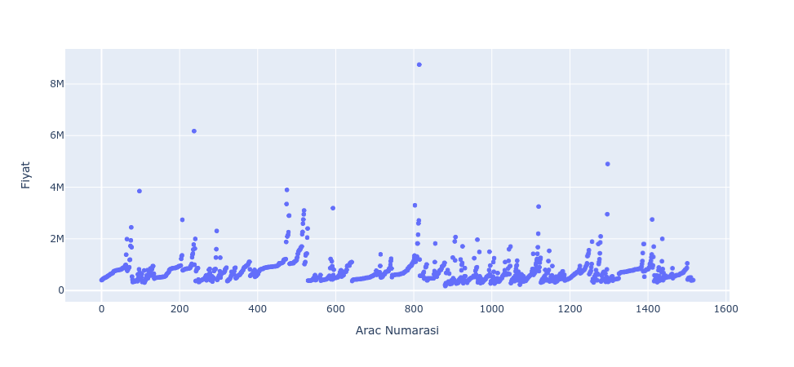
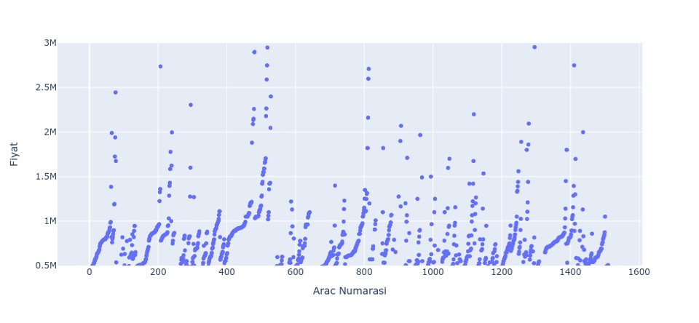
Raw Data of Car Prices (Scatter Plot)

Slide 5
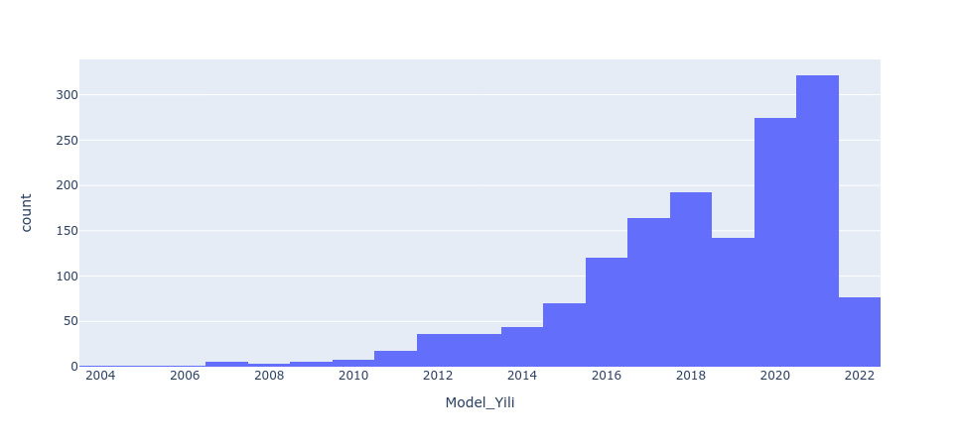
Manufacturing Year (Bar Plot)

Slide 6
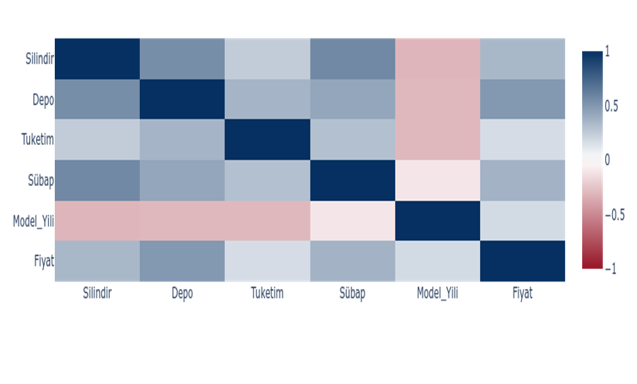
Correlation Matrix (For Numeric Values)

Slide 7
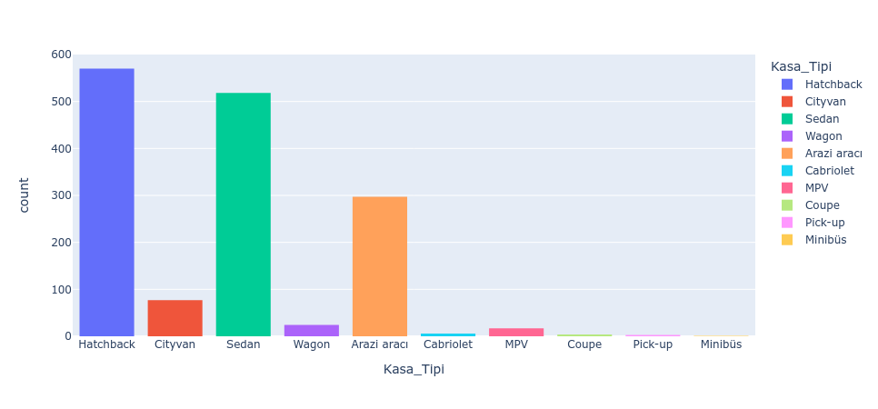
Case Types (Bar Plot)

Slide 8
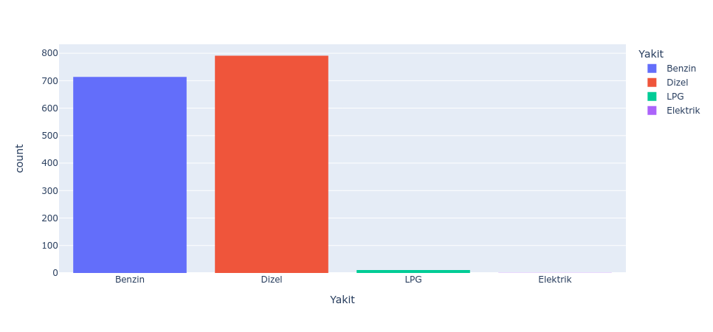
Fuel Type

Slide 9
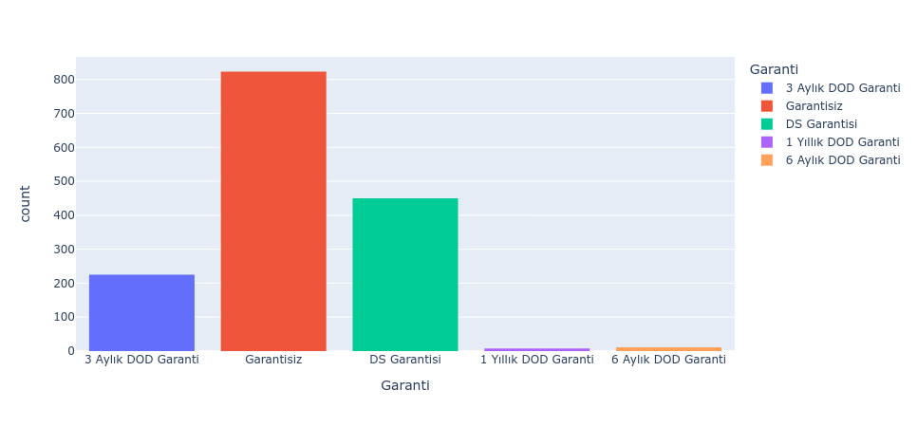
Warranty Period

Slide 10
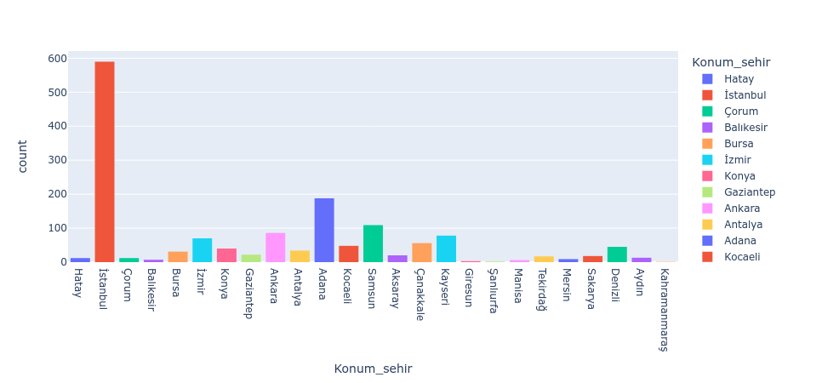
Location in Turkey

Slide 11
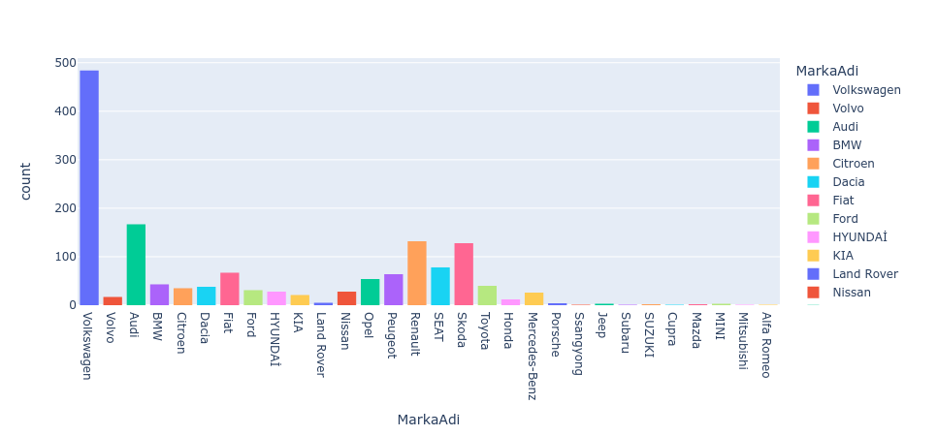
Brand Distribution (Bar Plot)

Slide 12
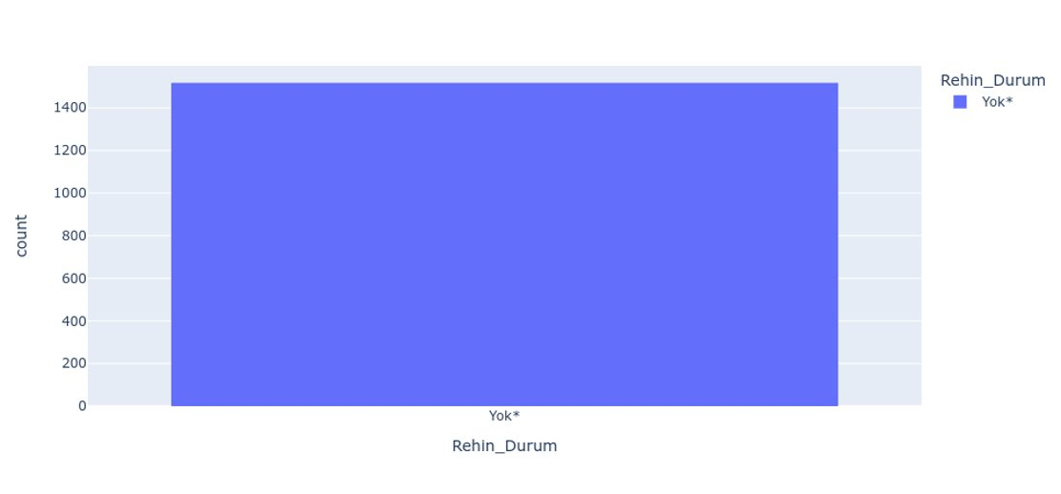
Pledged Asset (Bar Plot)

Slide 13
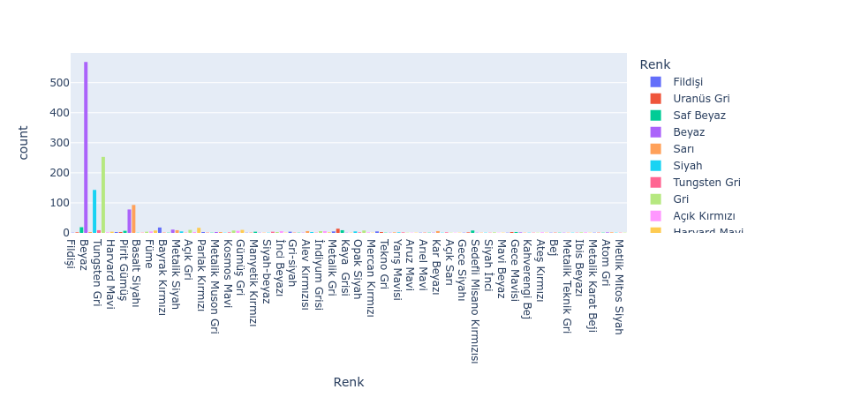
Color Distribution

Slide 14
BUILDING AI MODEL
Binary Encoder
Cleaning
Removed "₺" from Price(Fiyat)
Drop
"Elektrik" removed from Fuel(Yakit)
Categorize
Location_City(Konum_sehir) --> Location(Konum)
Encoder
Label Encoder
One-Hot Encoder
Warranty(Garanti)
Transform Data Types

Slide 15
Cleaning
Removed "₺" from Price(Fiyat)
Drop
"Elektrik" removed from Fuel(Yakit)
Categorize
Location_City(Konum_sehir) --> Location(Konum)
Warranty(Garanti)
Transform Data Types
Encoder
Label Encoder
One-Hot Encoder
Binary Encoder

Slide 16
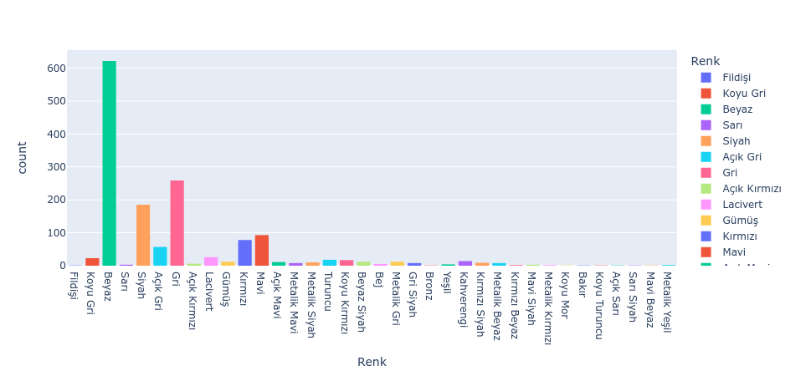
Color Distribution

Slide 17
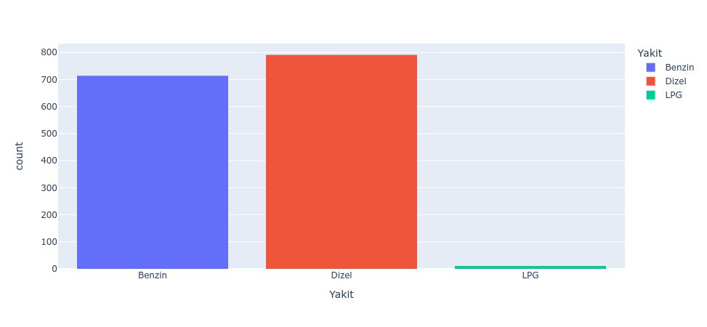
Fuel Type

Slide 18
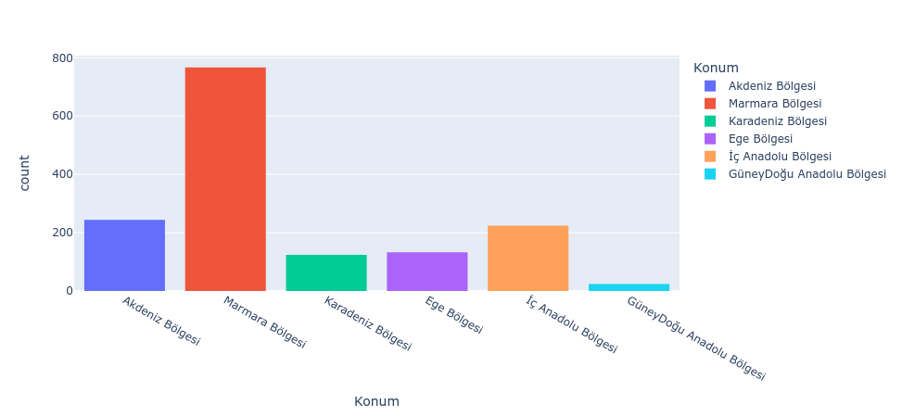
Location in Turkey

Slide 19
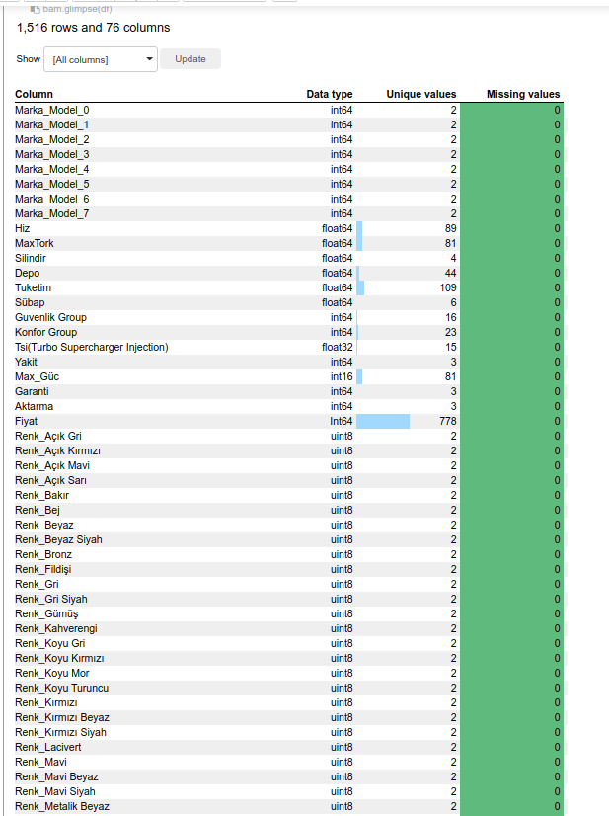
Data Before Training

Slide 20

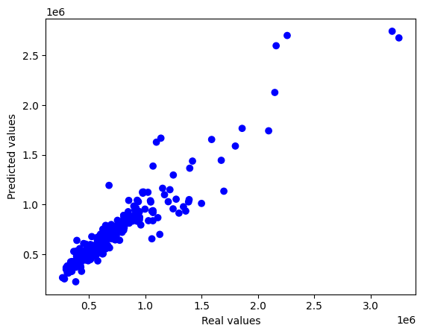
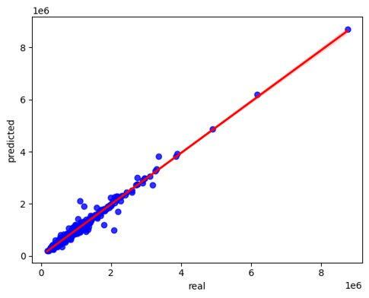
Model Visualiation

Slide 21
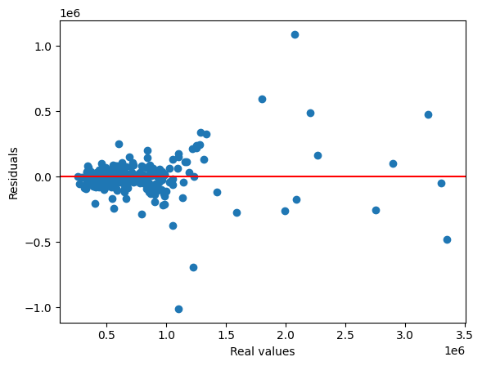
Overfitting Control
(Mean Square Error) MSE: 16738778014.85
(Root Mean Square Error) RMSE: 129378.43
(R2 Score) R2:0.888897599764878

Slide 22
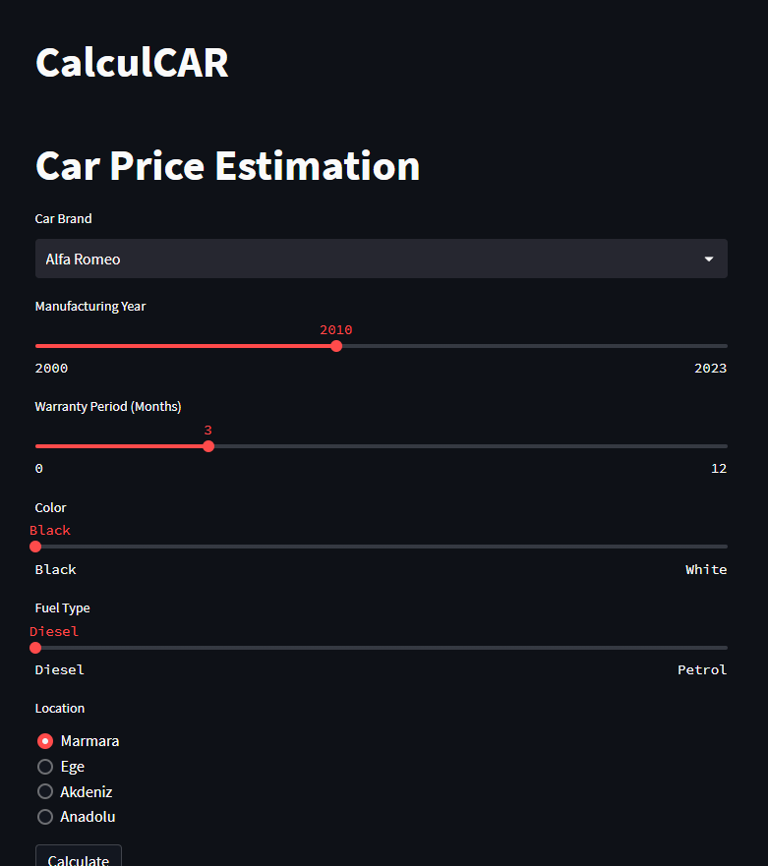
Demo Prototype

Slide 23
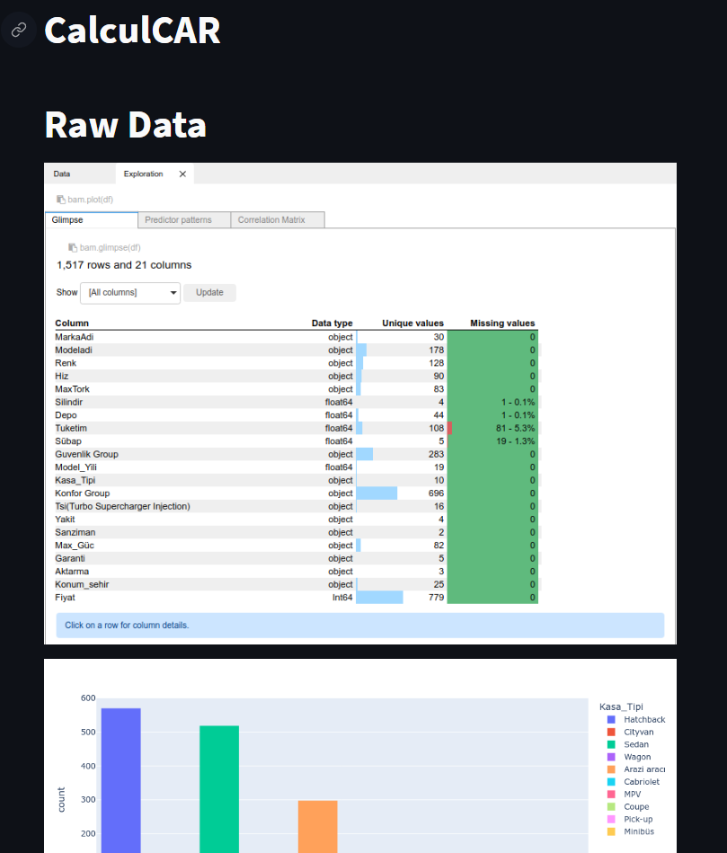
Demo Prototype

